Slide 1

PRESENTED BY:
PIYUSH NAUTIYAL(42925502716) AND
LEENA KAPOOR(01325502716)
UNDER THE GUIDANCE OF :
MR.SHEKHAR SINGH
TWITTER SENTIMENT AND ANALYSIS PRESENTATION OF PROJECT WORK

Slide 2
OUTLINES
Introduction
Problem statement
Solution Approach
Methodology
Real world application
Software hardware requirements
Future Work

Slide 3

INTRODUCTION
Twitter is an online news and social networking site where people communicate in short messages called tweets.
Tweeting is posting short messages for anyone who follows you on Twitter, with the hope that your messages are useful and interesting to someone in your audience.
Another description of Twitter and tweeting might be microblogging.

Slide 4



What is sentimental analysis
Sentiment Analysis is the process of ‘computationally’ determining whether a piece of writing is positive, negative or neutral.
It’s also known as opinion mining, deriving the opinion or attitude of a speaker.

Slide 5
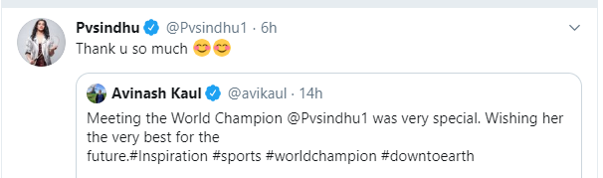
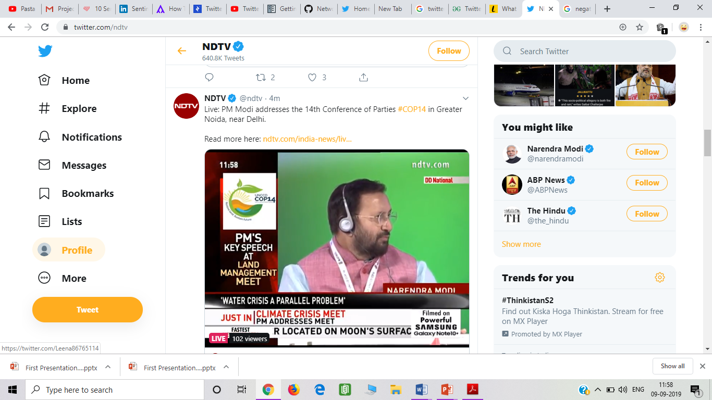
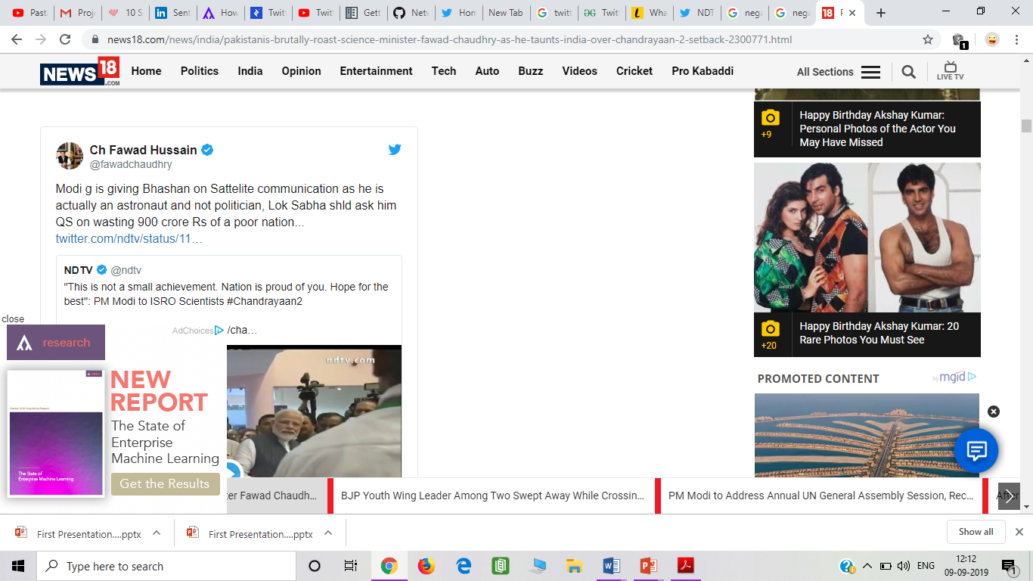
For example
Positive tweet
Neutral tweet
Negative tweet

Slide 6
PROBLEM STATEMENT
The problem in sentiment analysis is classifying the polarity of a given text at the document, sentence, or feature/aspect level .
whether the expressed opinion in a document, a sentence or an entity feature/aspect is positive, negative, or neutral .

Slide 7
Litrature survey
Research results show that machine learning methods, such as SVM and naive Bayes have the highest accuracy and can be regarded as the baseline learning methods, while lexicon-based methods are very effective in some cases, which require few effort in human-labeled document .We also studied the effects of various features on classifier.
We can conclude that more the cleaner data, more accurate results can be obtained. Use of bigram model provides better sentiment

Slide 8
METHODOLOGY
Social networking sites
(TWITTER)
Collect user opinion
Processing of opinions
Tokenizing
Algorithms
Training the data
Getting result
Stemming
Filtering
Testing data

Slide 9
SOLUTION APPROACH
We follow these 3 major steps in our program:
Authorize twitter API client and using Tweepy
Make a request to Twitter API to fetch tweets for a particular query.
Parse the tweets. Classify each tweet as positive, negative or neutral.(textblob)

Slide 10
SOFTWARE AND HARDWARE REQUIREMENTS
Windows/Linux operating system
Python 2.7
Text blob
Tweepy(Twitter API)
Modern web browser
Anaconda navigator

Slide 11
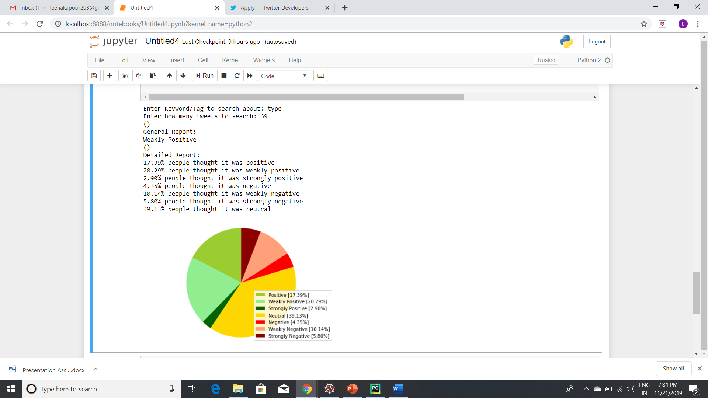
Results we obtained

Slide 12
REAL WORLD APPLICATION
Consider a product /brand x
Or consider about searching about what nation thinks

Slide 13

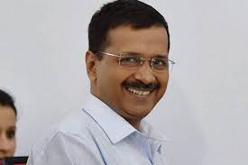








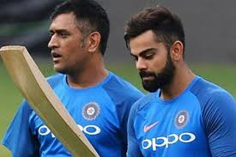


Slide 14

Sentiment analysis challenges

Slide 15
Future work
Work on fake news
And comparing results of different algorithms
Removing ironic comments
Taking care of emotions conveyed by abbreviations
Analysing which part of tweet is more important

Slide 16
Detecting emotions behind EMOJIS
There are two types of emojis Western emojis (e.g. :D) are encoded in only one or two characters,
Eastern emojis (e.g. ¯ \ _ (ツ) _ / ¯) are a longer combination of characters of a vertical nature. Emojis play an important role in the sentiment of texts, particularly in tweets.
emojis and their unicode characters that may come in handy when preprocessing tweets

Slide 17





Using datasets
Social media monitoring: Helps in prioritizing action and tracsing trends
Brand monitoring: Helps in better understanding and analyzing reputation of brand
Voice of customer (VoC): Understand the nuances of customer experience over time and needs
Market research:Analyze tweets and social media posts for real-time happening and reviews for unfiltered customer feedback
Fake news analysis

Slide 18

Dynamic plotting of graph
Plotting dynamic graph using python libraries like matplotlib and others.
Hashtag capturing

Slide 19
Comparison of machine learning algorithms
Naïve bias algorithm
Support vector machine
Maximum entropy

Slide 20

THANK YOU

